Slide 1
View Serializability

Slide 2
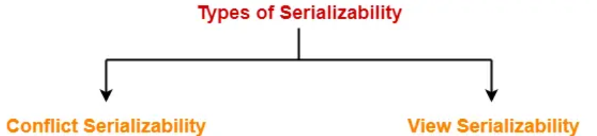
What is Serializability?
The concept of serializability helps to identify the correct non-serial schedules that maintains the consistency of the database.
There are two types of serializability-

Slide 3
View Serializability
If a given schedule is found to be view equivalent to some serial schedule, then it is called as a view serializable schedule.
View Equivalent Schedules-
Consider two schedules S1 and S2 each consisting of two transactions T1 and T2.
Schedules S1 and S2 are called view equivalent if the following three conditions hold true for them-
Initial readers must be same for all the data items.
Write-read sequence must be same.
Final writers must be same for all the data items.

Slide 4
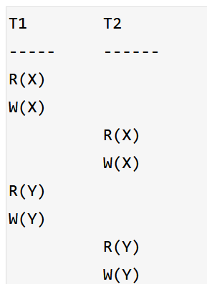
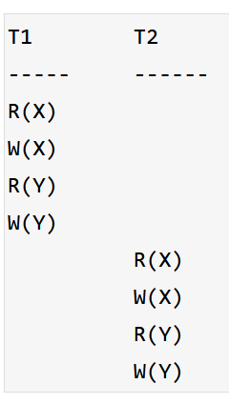
View Equivalent

Slide 5
Different Cases of Serializability
Case 1:
schedule is conflict serializable, then it is surely view serializable.
Case 2:
Suppose, schedule S is not conflict serializable, so, it may or may not be view serializable.
To check whether S is view serializable or not “check for blind writes”.
Case 3:
Schedule S is not conflict serializable, blind writes should be present.

Slide 6
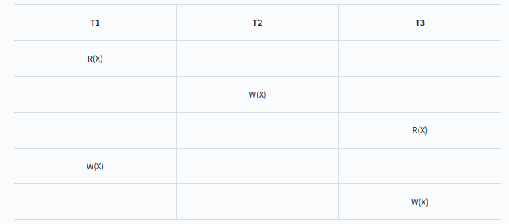
Blind Writes
Blind writes: If a write action is performed on a data item by a Transaction (updation), without performing the reading operation then it is known as blind write.
If Blind write is present then it may view serializable or not we have to check it.
If No blind write is present then it is not view serializable.
If the schedule is conflict serializable then it surely view serializable.

Slide 7
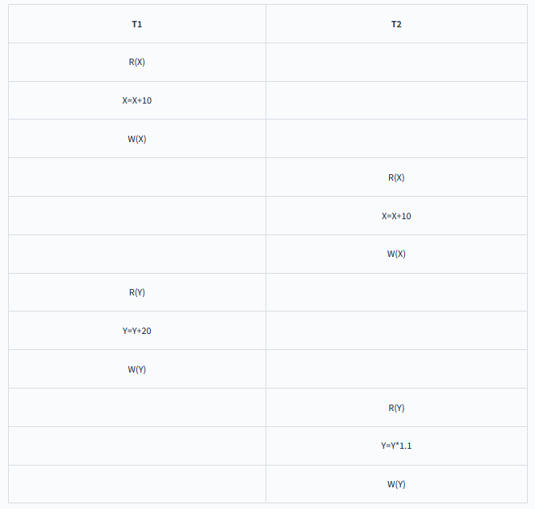
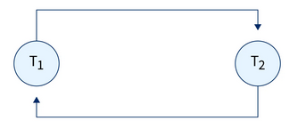
Examples
This is non conflict serializability as it contains cycles in the precedence graph.
But if the given schedule does not conflict with serializable, then we need to check for View Serializability.
If it is view serializable then it is consistent else it is inconsistent.
Thus, to address the limitations of conflict serializability, the concept of view-serializability was introduced.

Slide 8
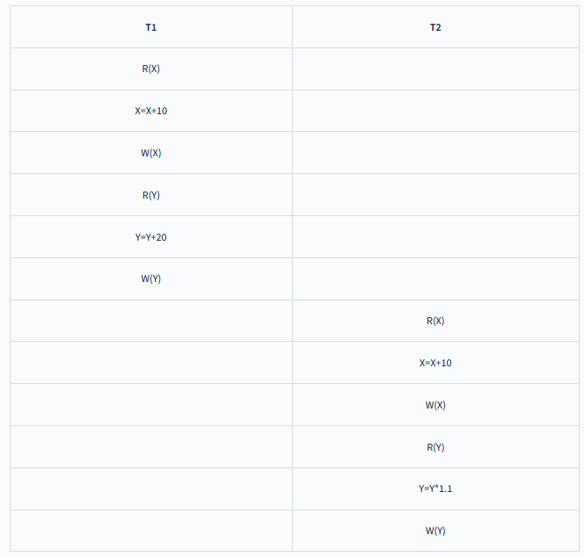
In the above example if we swap a few transaction operations, and format the table as follows:

Slide 9
Methods to Check View Serializability
To check View Serializability.
View Equivalent
If the given schedule is view-equivalent to the serial schedule itself then we can say that the schedule is view-serializable.
To generate the serial schedule of the given schedule, we follow the following steps:
Take the transaction say Ti that performs any operation first in the schedule. Write all the operations performed by that transaction one after the other in the given schedule.
Similarly, take another transaction that is performing any operation right after Ti in the given schedule and write all the operations performed by it below transaction Ti on any data item.
Follow the above steps for all the transactions. The order is very important.
Let us take the example of the table for checking View Serializability.

Slide 10
Non Serial Schedule S1
Serial Schedule S2

Slide 11
Conditions for View Serializability
Initial readers must be same for all the data items.
The Initial read is made by the T1 transaction for both the data items X and Y in Schedule S1 and in S2 as well as initial read is made by transaction T1 for both. Thus, the initial read condition is satisfied in S1 and S2 for data items X and Y.
Write-read sequence must be same.
The value of X and Y is updated by transaction T1 in schedule S1, which is read by transaction T2. In Schedule S2 the X and Y data items are updated by T1 and are read by T2 as well. Thus, in the above two schedules, the update read condition is also satisfied.
Final writers must be same for all the data items.
The final write for data items X and Y are made by Transaction T2 in Schedule S1. Also, the final write is made by T2 in Schedule S2 in Schedule S1 as well as serial schedule S2. Thus, the condition for the final write is also satisfied.
Result
As all three conditions are satisfied for our schedule S1 and its Serial Schedule S2, they are view equivalent.
Thus, we can say that the given schedule S1 is the view-serializable schedule and is consistent.

Slide 12
Questions
It is view serializable

Slide 13
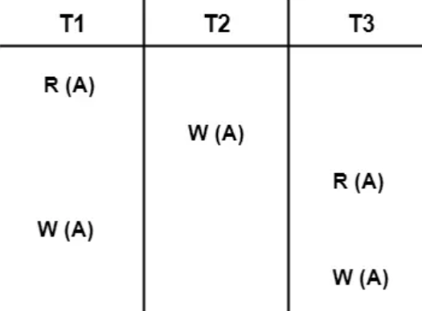
Questions
Check whether the given schedule S is view serializable or not. If yes, then give the serial schedule.
S : R₁(A) , W₂(A) , R₃(A) , W₁(A) , W₃(A)
View serializable

Slide 14
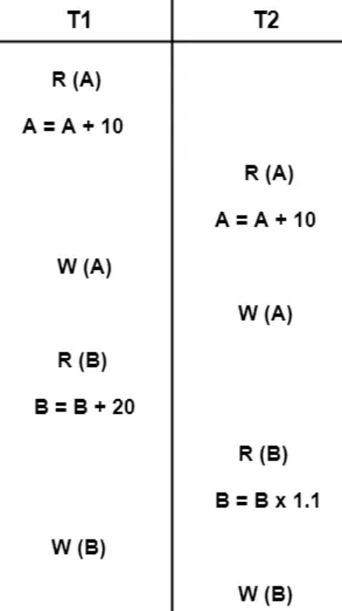
Questions
Not view serializable

Slide 15
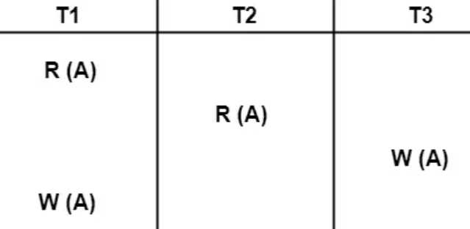
Questions
It is not view serializable

